Slide 1
To-do list
Simple Steps for Effective Task Management

Slide 2
What is to-do list?
Definition:
A list of tasks to be completed.
Purpose:
Helps prioritize and track tasks.

Slide 3
Flowchart
.
Class=container
h2
Input field(id=projname) for project name
Input field(id=task) for task
Input field(id=taskassignedby) for task assigned by
Input field(id=taskassignedto) for task assigned to
Input field(id=taskcompletion) for %task completion
Submit

Slide 4
Hidden container
.
Class=container2
Table id=datatable
<thead>
</thead>
<tbody> tbody contents have been added dynamically using
JavaScript</tbody>
Project name | task | Task assigned to | Task assigned by | % of task completion

Slide 5
Local storage
I used Local storage for storing the to-do list’s data.
Local storage is a browser feature that allows websites to store data locally on a user's device.
Ideal for storing to-do list data without the need for server-side databases.

Slide 6
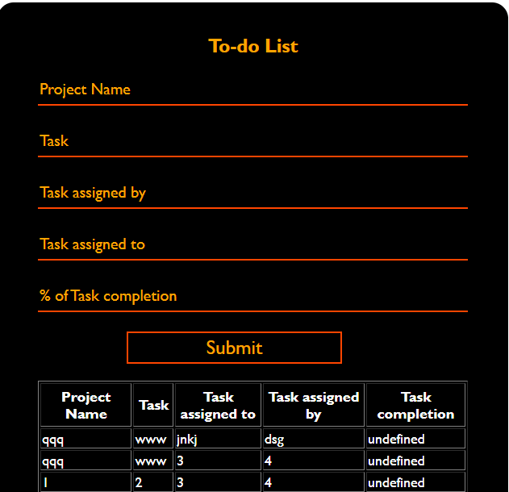
Output:

